Slide 1

Department of Computer Science South Asian University Chanakyapuri, New Delhi, India
On Defining Regions by Data Clustering for Increasing the TPS Rate of State-Based Blockchain
Supervisor:
Dr. Amit Banerjee
Assistant Professor
Department of Computer Science
South Asian University
Presenter:
M Mohaiminul Islam, SAU|CS(M)|2019|07
M.Sc. Computer Science
Department of Computer Science
South Asian University

Slide 2
Outline
Introduction
Motivation
Problem Statement
Proposed work & Contribution
Preliminary
Frequently Used Terminology of Blockchain
Proposed Approach
Overview of Proposed framework
Clustering of Transaction
Parallel mining concept
Experiment & Result
Conclusion
M Mohaiminul Islam| MSc. Computer Science | South Asian University

Slide 3
Introduction

Slide 4
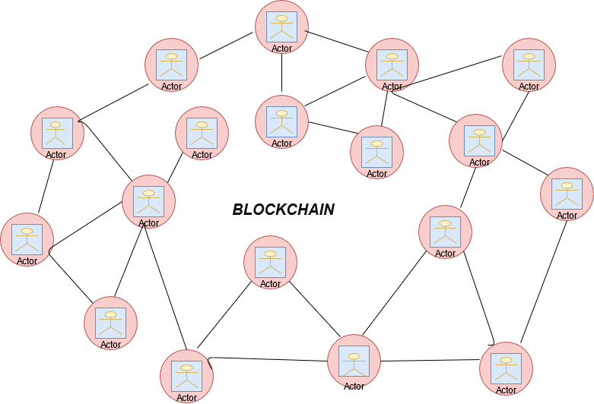
Introduction
Blockchain:
Blockchain is a collection of blocks. Each block contains a cryptographic hash, which means that if we change any small number or digit, the hash will change, which means that if we tamper with anything, the link to the previous block will be lost due to the hash changing, which is why this technology is so powerful. blockchains appear to be peer-to-peer networks. A node in the network may act as a miner or validator, and they enter into transactions. These transactions are then loaded onto the blockchain.Today supply chain, healthcare, different cryptocurrency uses this technology.
M Mohaiminul Islam| MSc. Computer Science | South Asian University

Slide 5
Motivation
In this thesis we use supply chain based blockchain. In a traditional supply chain, there are various issues. For example, in the food supply chain, we don't know how the food is processed, whether it's organic or not, there is a lack of information, data retrieval takes a long time, and the data is unreliable for product tracing. We can fix this issue through the use of blockchain technology but the current block size is only 1 MB with a TPS of only 7, and anyone initiating a transaction must typically wait 10 minutes. Thus, this is one of the major blockchain difficulties. In this thesis, we try to improve the TPS rate of a state-based blockchain, by clustering the transactions and parallel mining.
M Mohaiminul Islam| MSc. Computer Science | South Asian University

Slide 6
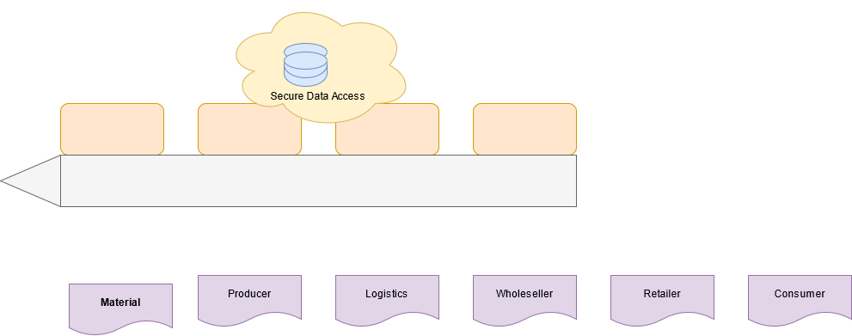
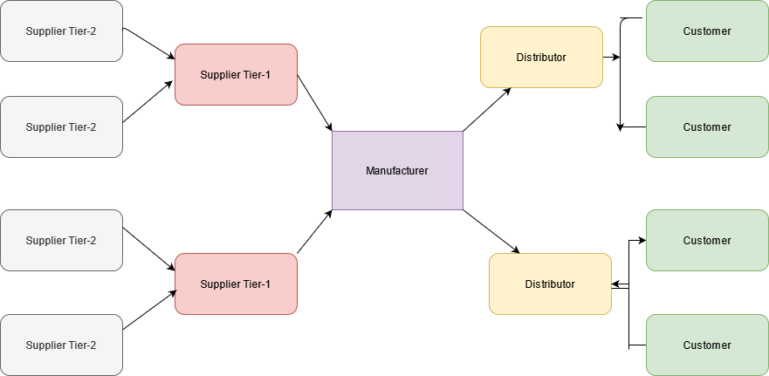
Continue…
Blockchain based SCM :
Traditional SCM:
M Mohaiminul Islam| MSc. Computer Science | South Asian University

Slide 7
Problem statement:
The primary difficulty with the blockchain is its limited throughput, which results from its slow transaction speed. when we increase the number of concurrent jobs in a chaincode, this supply chain-based blockchain takes a long time and its response time increases exponentially. Additionally, data retrieval takes a long time. For example, if we send 20 queries to the supply chain-based blockchain technology, we will receive a response in 0.5 sec. However, if we send 50 inquiries, it will take significantly longer, approximately 1 sec. The reason of low TPS rate is that the transactions are processed and verified serially. The goal of this thesis is to increase a blockchain's TPS rate through the use of the region-based parallel mining concept. This is accomplished by grouping transactions into distinct subsets. The proposed methodology not only increases the TPS rate, but also makes it easier to locate linked transactions in the blockchain.
M Mohaiminul Islam | MSc. Computer Science | South Asian University

Slide 8
Proposed Work & Contribution:
In this, we investigate a framework for improving the TPS rate of current day blockchains, by clustering the transactions into disjoint subsets and mining them in parallel. The proposed system can be used in any system that generates huge number of transactions and needs to validate the transactions in quickly, such as in supply chains or trading. In this proposed framework, we try to define the concept of regions by clustering the transactions into disjoint subsets to assist parallel mining for improving the TPS rate of a state-based blockchain. We perform a detailed evaluation to analyse the performance of the proposed system.
M Mohaiminul Islam | MSc. Computer Science | South Asian University

Slide 9
Preliminary

Slide 10
Basic Terminology Of Blockchain:
Miner:Anyone with sufficient computing power and a CPU can become a miner. miners solve a cryptographic puzzle and calculate a hash value in order to create a new block. The first person to solve this challenge and make a block will receive a reward.
Nonce: Nonce are essentially used to generate a hash, as we know that each block has a unique hash value to prevent data manipulation. Each unique value of a nonce generates a unique hash, and from that created hash, only one hash reaches the destination. If we modify the nonce, the hash will be modified.
Hash: A hash function is a cryptographic function that accepts numerical data of any length and converts it to numerical data of a fixed length. If we modify the input, the hash value changes as well.
Clustering of Data: It is a technique for disjointly grouping related or frequent elements. There are various methods that accomplish this, like k-Mean,DBSCAN.
Parallel Mining: Parallel mining is a concept that has been introduced in many researches to increase the TPS of a blockchain by mining the blocks concurrently.
Consensus Mechanism: Numerous consensus mechanisms are used in blockchain technology, including POW, POS, and PBFT to ensure security, trustworthy, and immutable in the blockchain. This technique ensures that each new block added to the blockchain is trusted and that the new block becomes part of the blockchain when all nodes in the blockchain agree on it.
M Mohaiminul Islam | MSc. Computer Science | South Asian University

Slide 11
Proposed Approach

Slide 12
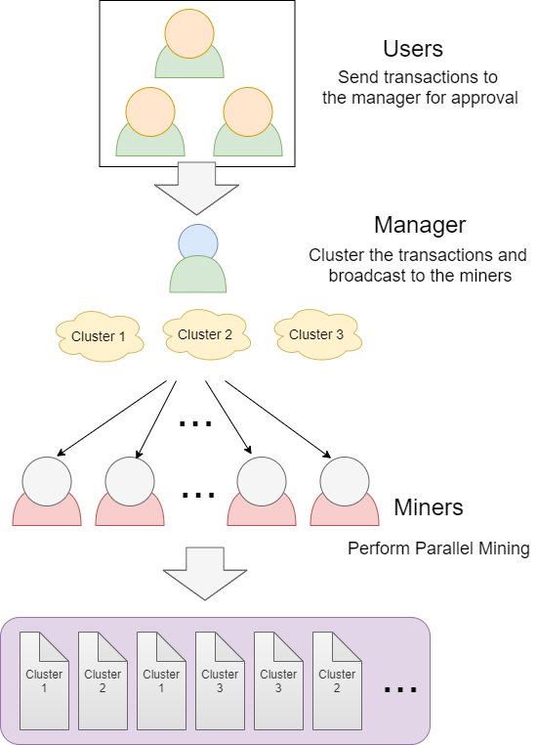
Overview of Proposed framework
Here presents an overview of the proposed system framework. In the we consider the inclusion of a designated server for clustering the transactions. It is referred to as the Manager in the proposed framework. It is assumed that the transactions of all users, passes through the manager..
System model-------→
M Mohaiminul Islam | MSc. Computer Science | South Asian University

Slide 13
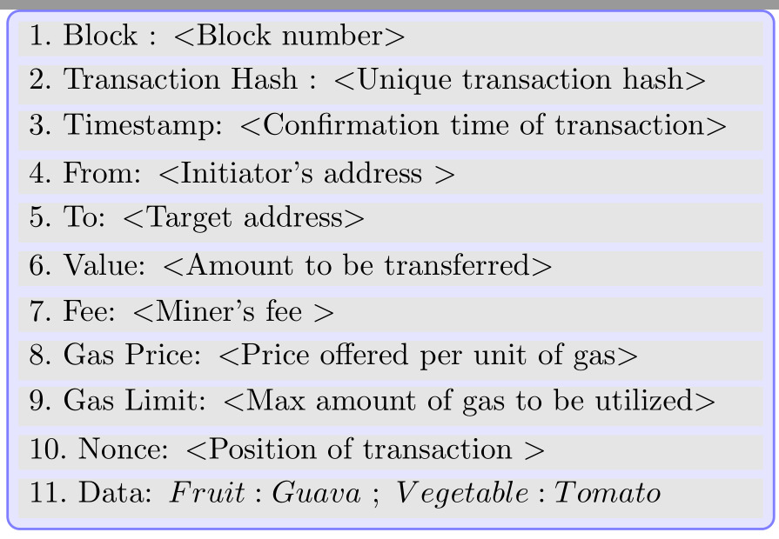
Continue..
The manager collects all transactions and can cluster the data into disjoint subsets. Finally it broadcasts each cluster to the miners. The miners can accept any cluster or clusters that it wants to mine and finally upon successful verification the transactions are included in the blockchain.
Block Transaction diagram---→
M Mohaiminul Islam | MSc. Computer Science | South Asian University

Slide 14
Continue…
A blockchain transaction consists in diagram of various fields, including to, from, amount, nonce,hash, timestamp,mine fee,nonce,gas fee,gas limit and data. The to and from fields are the unique addresses of the initiator and the target entities.The amount field shows the value transferred by the initiator. The timestamp shows when the transaction is initiated and the data field contains additional information about the transaction.In figure we show the example of a blockchain transactions.For example the first transaction shows that the U1 is transferring 10 dollars to U2 at timestamp TS1 to buy The users of the proposed framework can initiates such transactions and forward the same to the manager for clustering. The manager periodically checks this incoming transactions and can use any clustering algorithm like K-Means for grouping the transaction into disjoint subsets
M Mohaiminul Islam | MSc. Computer Science | South Asian University

Slide 15
Continue…
In this figure, we show three cluster where the algorithm uses the first data field as a parameter for clustering. In the figure shows three clusters of meat,veg and fruits. The manager finally broadcast the transactions of each cluster for parallel mining. The details of the proposed framework is given below.
M Mohaiminul Islam | MSc. Computer Science | South Asian University

Slide 16
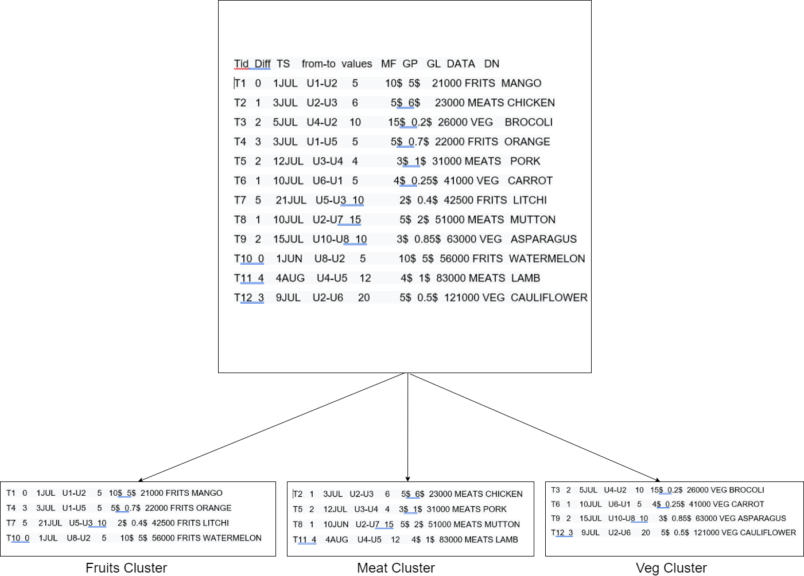
Continue…
M Mohaiminul Islam | MSc. Computer Science | South Asian University

Slide 17
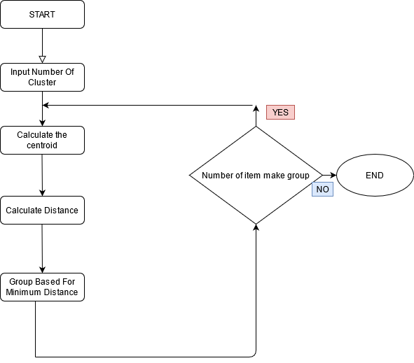
Clustering of Transaction
Since data of various transactions are distributing throughout the ledger, we need to cluster these to form a similar related transaction for a block. In our implementation, we apply the K-Means clustering algorithm to group these similar transactions into different clusters
Flow chart of K-Mean:
M Mohaiminul Islam | MSc. Computer Science | South Asian University

Slide 18
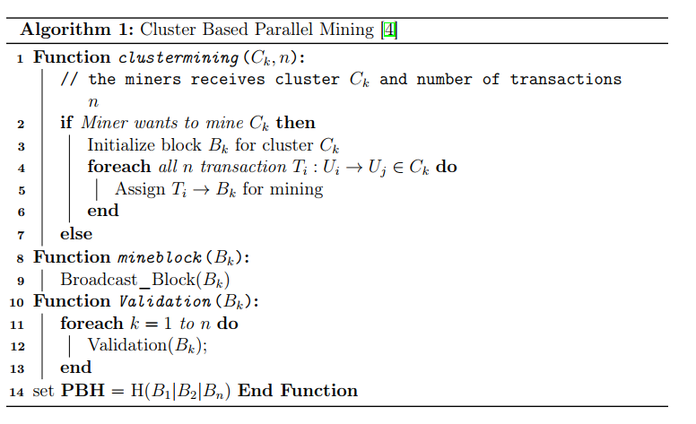
Parallel Mining Concept
After clustering, the manager broadcast this cluster to the miners and then miners mined it region based parallel mining.we can achieve the better TPS rate by using parallel mining rather than solo mining.for that we have to divide the blockchain network into n different segments called as regions and cluster this regions.in this method a miner can only mine for a specific region.
Cluster based parallel mining
algo
M Mohaiminul Islam | MSc. Computer Science | South Asian University

Slide 19
Continue…
The pseudocode for the cluster based parallel mining technique strategy is which is a variation of the algorithm described by the authors in It is comprised of two functions: ClusterMining() and Validation(). Miners use these routines to mine blocks in a cluster and to validate the blockchain. We assume in ClusterMining() that miners are evenly distributed throughout the clusters, i.e., any cluster can be chosen by any miners. Another supposition made in the pseudocode is that the number of clusters is pre-determined. Take note that these variables can vary according to the amount of transactions in a region, the total transaction costs, and the competition between the miners. PBH is the preceding block hash in the function, which is appended to the block to prevent data tampering.
M Mohaiminul Islam | MSc. Computer Science | South Asian University

Slide 20
Experiment & Result

Slide 21
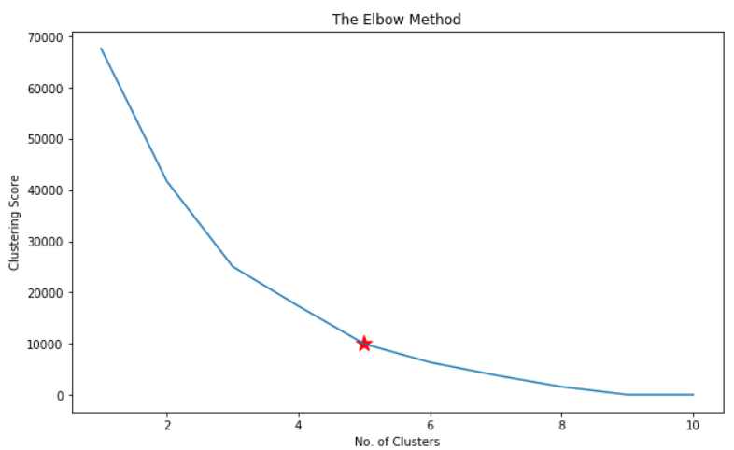
Clustering Transactions
For the experiment, we consider 70 user where making random transactions for purchasing different product items. We use python 3.0 for implementing the K-Mean algorithm and show the result of our dataset.
This Elbow method shows the how many
cluster will be good for this transaction
Dataset.this red start indicate that if we
take 5 cluster then our related
Transaction will be cluster nicely.Though
Here we take 3 cluster.
M Mohaiminul Islam | MSc. Computer Science | South Asian University

Slide 22
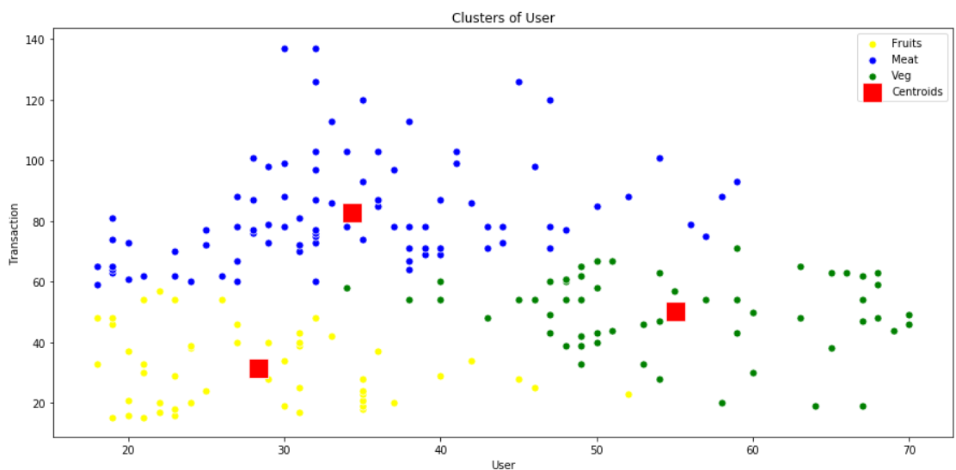
Continue…
Here we take 3 clusters: the fruits cluster and the other two are veg cluster and meat cluster.And this figure we cluster our transaction dataset and The yellow color shows the fruits cluster means this algorithm cluster all the fruits related item and blue color shows the meat cluster and green color indicates the veg cluster where all the meat and veg related items are clustered.now we can put this related transaction item into the blockchain and after mining them parallelly so that we can achieve better TPS rate.
M Mohaiminul Islam | MSc. Computer Science | South Asian University

Slide 23
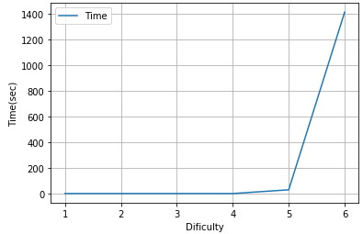
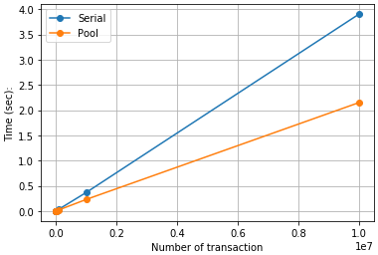
Comparison of sequential and parallel mining
solo mining parallel mining
in the solo mining graph, we see that with the transactionif the transactions are increased, it take slots of
time to validate the transaction.
M Mohaiminul Islam | MSc. Computer Science | South Asian University

Slide 24
Continue…
On the other hand ,in parallel mining graph, we see that with the transaction that if the transactions are increased, it takes less time to validate the transaction.
M Mohaiminul Islam | MSc. Computer Science | South Asian University

Slide 25
Conclusion

Slide 26
Conclusion & Future Work
In a blockchain system, it is clear that low TPS rate is the major issue that affects its acceptance. The goal of this work is to investigate a framework for increasing the TPS rate of modern blockchains by grouping transactions into disjoint groups and mining them concurrently. A dedicated server is used to cluster the data and disseminate the transactions to the miners. Transactions can be utilised to search the blockchain due to data clustering. We implement the proposed approach using k-mean algorithms for data clustering. Our experimental results indicate the proposed methodology improves the TPS rate of the blockchains and group related transactions together for faster search. In the future, we want to do experimental research on the system using an actual supply chain.
M Mohaiminul Islam | MSc. Computer Science | South Asian University

Slide 27

Thank You Everyone for your Time!!!

Slide 28
References
Shrey Baheti, Parwat Singh Anjana, Sathya Peri, and Yogesh Simmhan.Dipetrans: A framework for distributed parallel execution of transactions of blocks in blockchain. arXiv preprint arXiv:1906.11721, 2019
homas Dickerson, Paul Gazzillo, Maurice Herlihy, and Eric Koskinen. Addingconcurrency to smart contracts.Distributed Computing, pages 1–17, 2019.
Mohd Sameen Chishti and Amit Banerjee. Increasing tps rate of state-basedblockchains by parallel mining.Internet Technology Letters, 4(2):e220, 2021. 10,14, 19, 20
K Lino Fathima Chinnarani et al. Pplfs: A high performance consensusmethod for improving throughput and scalability in blockchain network.TurkishJournal of Computer and Mathematics Education (TURCOMAT), 12(11):3705–3714, 2021. 14
shrey Baheti, Parwat Singh Anjana, Sathya Peri, and Yogesh Simmhan.Dipetrans: A framework for distributed parallel execution of transactions ofblocks in blockchain.arXiv preprint arXiv:1906.11721, 2019. 10, 14
Reshma Kamath. Food traceability on blockchain: Walmartâs pork and mango pilots with ibm.The Journal of the British Blockchain Association, 1(1):3712,2018. 4
M Mohaiminul Islam | MSc. Computer Science | South Asian University

Slide 29
References
Jia Kan, Shangzhe Chen, and Xin Huang. Improve blockchain performanceusing graph data structure and parallel mining. In2018 1st IEEE InternationalConference on Hot Information-Centric Networking (HotICN), pages 173–178.IEEE, 2018. 10, 14
Sidra Malik, Volkan Dedeoglu, Salil S Kanhere, and Raja Jurdak. Trustchain:Trust management in blockchain and iot supported supply chains. In2019 IEEEInternational Conference on Blockchain (Blockchain), pages 184–193. IEEE, 2019.
Takahiko Shintani and Masaru Kitsuregawa. Parallel mining algorithms forgeneralized association rules with classification hierarchy. InProceedings of the1998 ACM SIGMOD international conference on Management of data, pages 25–36, 1998. 14
Tobias Sund and Claes Lööf. Performance evaluation of a blockchain-basedtraceability system: A case study at ikea, 2019. 12
Shihab Shahriar Hazari and Qusay H Mahmoud. A parallel proof of work toimprove transaction speed and scalability in blockchain systems. In2019 IEEE9th Annual Computing and Communication Workshop and Conference (CCWC),pages 0916–0921. IEEE, 2019. 1, 4, 14
M Mohaiminul Islam | MSc. Computer Science | South Asian University

